Slide 1
WA National Standard Medication Chart (NSMC) Audit 2026
Train the Trainer

Slide 2
Acknowledgement of country
May I first acknowledge the Whadjuk people of the Noongar nation, the traditional custodians of this land who are resilient in their custodianship.
Let us celebrate their culture today and every day and note how privileged we are to share this country.
I pay my respects to elders: past, present and emerging.

Slide 3
WA National Standard Medication Chart (NSMC) Audit
In previous years, the Australian Commission for Safety and Quality in Health Care (ACSQHC) had coordinated a biennial NSMC Audit.
The last NSMC Audit was conducted in 2024 where WA conducted an abridged statewide audit which focused on key areas identified for improvement from the 2022 audit.
In 2026, the NSMC audit will focus on key areas identified for improvement from the previous audit, along with additional areas that were requested by the WA Medication Safety Collaborative (WA MSC).
Using and auditing the NSMC are activities that can be used to demonstrate compliance with the NSQHS Standards for accreditation.
It is a policy compliance requirement for WA sites to participate in this statewide audit as per Medication Chart Policy MP0078/18.

Slide 4
WA 2026 NSMC Audit Objectives
Review areas identified as requiring improvement from the statewide NSMC audit in 2024:
  Adverse Drug Reactions (ADR)
  Venous Thromboembolism (VTE) risk assessment
Additional areas to be included in the 2026 audit:
  Regular medicine orders
  PRN medicine orders
  Once only, nurse initiated and phone orders

Slide 5
WA NSMC Audit
Data Collection Tools
Paper based form, available at:
http://ww2.health.wa.gov.au/Articles/U_Z/WA-Hospital-Medication-Chart
The WA NSMC 2026 audit will be coordinated via REDCap®
https://redcap.link/NIMC2026

Slide 6
Preparing for the NSMC Audit
Site Coordinators will require access to the REDCap® project to be able to run reports for their site.
Register for access to REDCap®.
  Complete the registration form to gain access to the REDCap® system
Users will then need to email MTU to request access to the National Standard Medication Chart Audit 2026 REDCap® project.
Auditors can use the REDCap® link provided to enter data, alternatively they can request access to the REDCap® project if deemed appropriate by Site Coordinators.

Slide 7
Number and type of charts to audit
Suggested audit sample size:
Ideally all available active WA Hospital Medication Charts (WA HMC), adult and paediatric, should be reviewed.
It is recommended that as many medication charts are reviewed as possible to identify of errors that occur infrequently and to evaluate any significant changes to medication safety.
Hospital bed numbers | Sample size
150 or more | 20% of current inpatients
30 – 149 | 30 current inpatients
Less than 30 | All current inpatients

Slide 8
Audit teams
Multidisciplinary audit teams are recommended to reflect the way in which clinicians use the WA Hospital Medication Chart (WA HMC – Adult and Paediatric)
Ideally it should be conducted by 2 people together:
  To minimise observer bias
  Should include:
    A registered nurse
    A pharmacist (or medical officer, or another nurse)
The teams should be allocated and maintained for the audit period, to ensure consistency in the data collected.

Slide 9
Recommendations
It is recommended that auditors enter the data directly into REDCap, however, a paper tool (one per patient) has been provided to assist auditors in collecting the information prior to upload into REDCap®.
Auditors involved with audit data entry will need to familiarise themselves with the REDCap® Audit tool.
It is suggested that auditors maintain a log of frequently occurring errors/issues that can be used as examples in your site report.
  e.g. Use of patient ID labels without first prescriber handwriting patient name
  e.g. Partially complete or incomplete ADR documentation
  e.g. Frequently used error-prone abbreviations
  Can be used for education/improvement at each site
Take de-identified photos/photocopies of any major issues – to present to sites Medicines & Therapeutics Committee or Medication Safety Group
  May be a once-off event
  May be part of a pattern

Slide 10
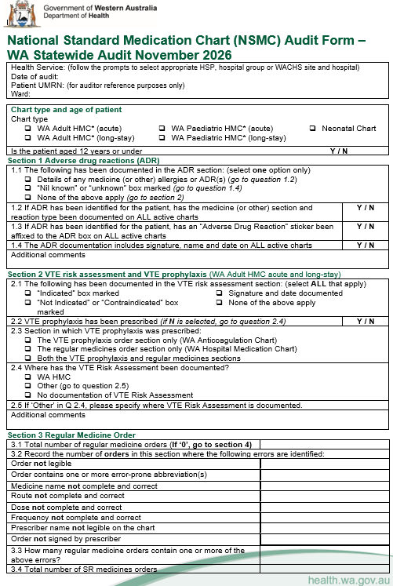
Completing the Audit
Front Page

Slide 11
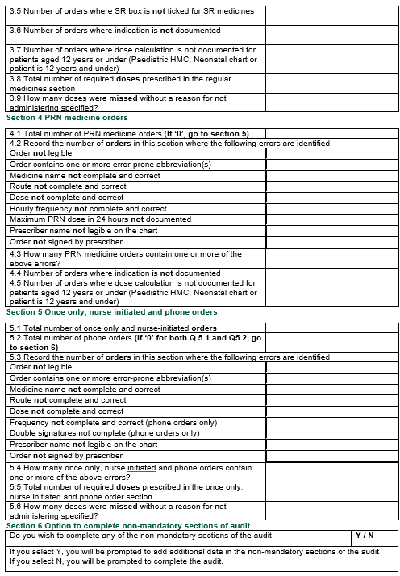
Completing the Audit
Back page

Slide 12
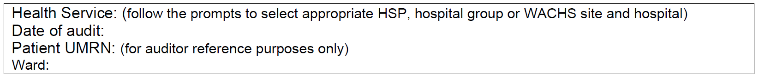
Completing the Audit Tool
Complete one audit tool per patient – direct entry into REDCap tool is recommended
Complete all fields on top of page:
  Health Service
  Date of audit
  Unique Medical Record Number (UMRN) and ward – this documentation is for auditor reference purpose only

Slide 13
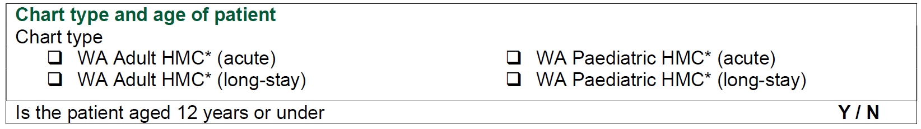
Chart type and age of patient
Record the chart type being audited for the patient
For adult charts – select either WA Adult HMC acute or long-stay version
For paediatric charts – select either WA Paediatric HMC acute or long-stay version
Only include charts that are “active” and in current use at the time of the audit
NOTE: HMC stands for Hospital Medication Chart

Slide 14
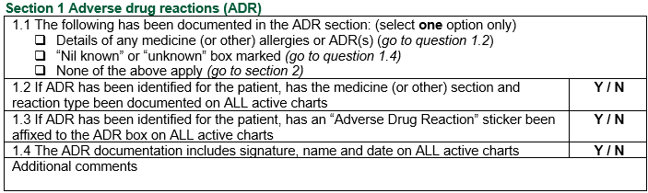
Adverse Drug Reaction (ADR) Details
This audit focuses on medicine and/or treatment related ADRs/allergies.
1.1 The following has been documented in the ADR section
Select ONE option only.
Depending on your answer, you may be either be prompted within the REDCap® program to answer all the questions in this section or move to section 2 of the audit.
1.2 If ADR has been identified for the patient, has the medicine (or other) section and reaction type has been documented on ALL active charts
Documentation needs to include medicine AND reaction type.
If reaction is documented as “patient unsure” or “patient can’t remember”, it is considered complete – select YES.

Slide 15
Adverse Drug Reaction (ADR) Details
1.3 If ADR has been identified for the patient, has an “Adverse Drug Reaction” sticker been affixed to the ADR box on ALL active charts
Select either YES or NO. Please also refer to the back page (page 4) of the WA HMC to see if the sticker has been affixed here.
1.4 The ADR documentation includes signature, name and date on ALL active charts
Documentation needs to include name and signature of person documenting AND the date of documentation.

Slide 16
Adverse Drug Reaction (ADR) Details
This section relates to medicine or treatment related ADRs
Although the ADR section can be used to document all allergies/ADRs based on local policy, the focus of the NSMC audit is to identify medicine and/or treatment related ADRS as a patient safety feature.
If a non-medicine or treatment related allergy is documented in the ADR box, then answer this section as per the following:
1.1 The following has been documented in the ADR section: (select one option only) Details of any medicine (or other) allergies or ADR(s) (go to question 1.2) “Nil known” or “unknown” box marked (go to question 1.4) None of the above apply (go to section 2)
Additional comments Non-medicine or treatment related ADR documented in the ADR box
✓

Slide 17
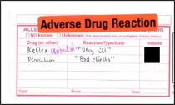
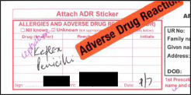
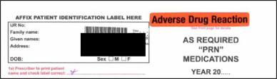
ADR - Example
1.1 The following has been documented in the ADR section: (select one option only) Details of any medicine (or other) allergies or ADR(s) (go to question 2.2) “Nil known” or “unknown” box marked (go to question 2.4) None of the above apply (go to section 3)
1.2 If ADR has been identified for the patient, has the medicine (or other) section and reaction type been documented on ALL active charts | Y / N
1.3 If ADR has been identified for the patient, has an “Adverse Drug Reaction” sticker been affixed to the ADR box on ALL active charts | Y / N
1.4 The ADR documentation includes signature, name and date on ALL active charts | Y / N
Additional comments
✓

Slide 18
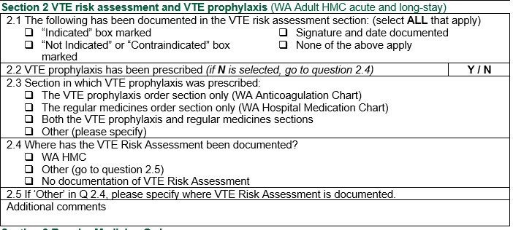
VTE Risk Assessment and
VTE Prophylaxis
Note: The following section has been adjusted accordingly to align with both WA HMC and WA Anticoagulation Medication Chart (WA AMC)

Slide 19

VTE risk assessment and prophylaxis
2.1 The following has been documented in the VTE risk assessment section: (select ALL that apply)
“Indicated” box marked “Not Indicated” or “Contraindicated” box marked | Signature and date documented None of the above apply
2.1 The following has been documented in the VTE risk assessment section (select ALL that apply)
Refer to Pharmacological Prophylaxis section:
  If “Indicated” box is marked select this option.
  If “Not indicated” or “Contraindicated” box is marked select this option.
If prescriber has signed and dated the VTE risk assessment box, select “signature and date documented”.
VTE risk assessment must be completed on at least ONE active WA HMC. If not, select "None of the above apply".

Slide 20
VTE Prophylaxis
2.2 VTE prophylaxis prescribed
Check whether the patient has been prescribed VTE prophylaxis
Select YES if pharmacological VTE prophylaxis has been prescribed
Select NO if no pharmacological VTE prophylaxis has been prescribed.
You will be directed to question 3.4
*WA public hospitals will only be considering pharmacological VTE prophylaxis (and not mechanical)

Slide 21
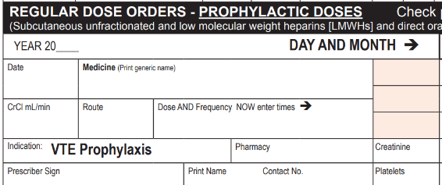
VTE Prophylaxis
2.3 Section in which VTE prophylaxis was prescribed: The VTE prophylaxis order section only (WA Anticoagulation Chart) The regular medicines order section only (WA Hospital Medication Chart) Both the VTE prophylaxis and regular medicines sections Other
2.3 Section in which VTE prophylaxis prescribed:
Select only ONE option as to where the VTE prophylaxis has been prescribed.
Refer to the “VTE prophylaxis order section” of the WA Anticoagulation Medication Chart. Select “VTE prophylaxis order section” if a pharmacological VTE agent has been prescribed here.
Refer to the “regular medicines order section” of the WA HMC. Select “regular medicines order section” if a pharmacological VTE agent has been prescribed here.
If prophylaxis is prescribed elsewhere select “Other” and then specify location

Slide 22
VTE Prophylaxis
2.4 Where has the VTE Risk Assessment been documented? WA HMC Other (go to question 2.5) No documentation of VTE Risk Assessment
2.5 If ‘Other’ in Q 2.4, please specify where VTE Risk Assessment is documented.
2.4 Where has the VTE Risk Assessment been documented?
Select only ONE option as to where the VTE Risk Assessment has been documented.
If this is documented elsewhere than the WA HMC, select ‘Other’ option and you will be prompted to specify where this is documented in Q2.5.
If there is no VTE Risk Assessment documented, select ‘No documentation of VTE Risk Assessment’.

Slide 23
VTE Prophylaxis
Digital Medical Record (DMR) - Advice
This process is only for sites where local policies, procedures and/or guidelines refer clinicians to document VTE Risk Assessment elsewhere than the recommendation documentation on the WA HMC
Potential way to search for VTE Risk Assessment in the DMR
  Refer to the eform where the VTE Risk Assessment is documented with in the DMR
  If the audit date is close to patient’s admission – review the medical progress notes corresponding to the date of admission or possibly the day after
  If VTE prophylaxis has been prescribed – review the medical progress note entries in DMR on the date of prescription

Slide 24
VTE Prophylaxis
Digital Medical Record (DMR) – Advice (continued)
Identifying if a VTE Risk Assessment has been documented and completed should be quick.
Auditors should not spend more than a realistic amount of time to identify this. If the search takes longer than a few minutes than select ‘No documentation of VTE Risk Assessment’.
Auditors are recommended to add further detail in the additional comments section with suggested wording “DMR search. No VTE Risk Assessment found”

Slide 25

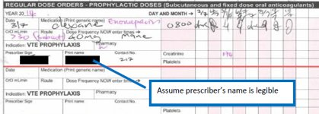
VTE risk assessment and
VTE prophylaxis
2.1 The following has been documented in the VTE risk assessment section: (select ALL that apply)
“Indicated” box marked “Not Indicated” or “Contraindicated” box marked | Signature and date documented None of the above apply
2.2 VTE prophylaxis has been prescribed (if N is selected, go to question 2.4) |  | Y / N
2.3 Section in which VTE prophylaxis was prescribed: The VTE prophylaxis order section only (WA Anticoagulation Chart) The regular medicines order section only (WA Hospital Medication Chart) Both the VTE prophylaxis and regular medicines sections
2.4 Where has the VTE Risk Assessment been documented? WA HMC Other (go to question 2.5) No documentation of VTE Risk Assessment
Additional comments
✓
✓
✓
✓
WA HMC:
WA AMC:

Slide 26
Medicine Orders Section 3 - 5
Orders should be considered complete and correct where there is no potential for misinterpretation or administration error, based on the documentation on the chart:
Section 3 Regular medicine orders
Section 4 PRN medicine order
Section 5 Once-only, nurse initiated and phone orders

Slide 27
Medicine order section
Total number of medicines orders
The following relate to questions
    3.1
    4.1
    5.1
    5.2
This relates to all the medicine orders in the specified section (regular, PRN, once only etc.) of all active charts.
    Includes only active orders
    Exclude any ceased orders

Slide 28
Medicine Order Section
Record the number of orders in this section where the following errors are identified
The following relate to questions :
  3.2
  4.2
  5.3
Review all the orders in the specified medicines section
Record the number of orders where the specified error was identified
Record number of orders not the total number of errors
Put a ‘0’ in the box if there are no orders with the specified error

Slide 29
Type of errors
Order not legible
Order contains one or more error-prone abbreviations
Not complete and correct- this only refers to incomplete or incorrect medicine orders related to the following medicine sections:
  Medicine name
  Route
  Dose
  Frequency
  (error prone abbreviations are a separate error type)
Prescriber name not legible on the chart
Order not signed by prescriber

Slide 30
Medicine order section
Error-prone abbreviations – some examples
Error prone abbreviation | Intended meaning | Correct Abbreviation
ug, mcg or μg | Microgram | Microgram or microg
U or u | Unit | Unit(s)
OD, od or d | Once daily | Daily, or specific time (e.g. mane, nocte)
QD or qd | Every day | Daily, or specific time (e.g. mane, nocte)
Q4H, q4h | Every 4 hours | Every 4hours, 4 hourly, 4hrly
SC or S/C | Subcutaneous | Subcut or subcutaneous
SL or S/L | Sublingual | Subling or sublingual
.5mg | 0.5mg | 0.5mg or 500microgram or 500microg
5.0mg | 5mg | 5mg
Drug name abbreviations | e.g. AZT = zidovudine | Do not use abbreviations for medicine names.

Slide 31
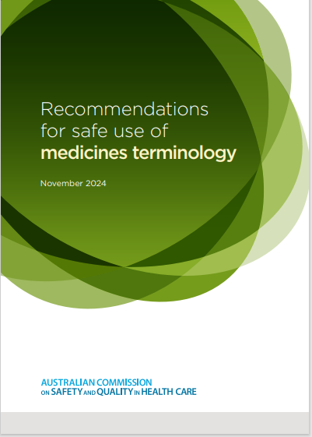
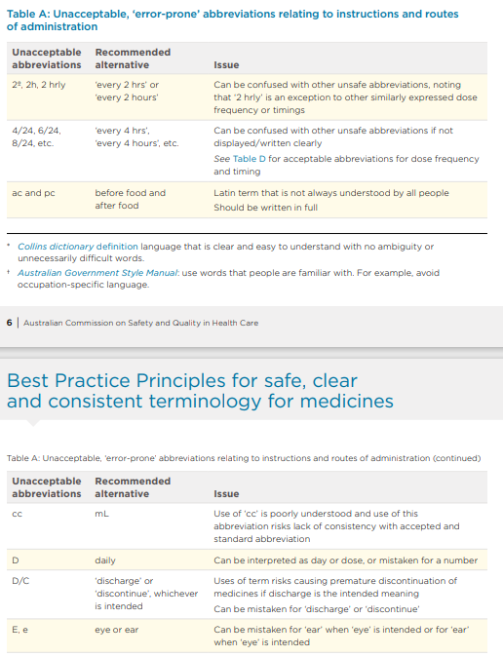
Medicine order section
Error-prone abbreviations (continued)
Hospitals may have their own more extensive list of error prone abbreviations
Refer to Commission’s
Recommendations for safe use of medicines terminology

Slide 32
Medicine order section
Error-prone abbreviations (continued)
A separate non-mandatory question immediately follows this section for sites who may wish to annotate the type of error-prone abbreviations identified during the audit.
As this is non mandatory, sites will need to instruct auditors if they will annotate the error-prone abbreviations identified on the chart.
This information may assist in education and quality improvement purposes.

Slide 33
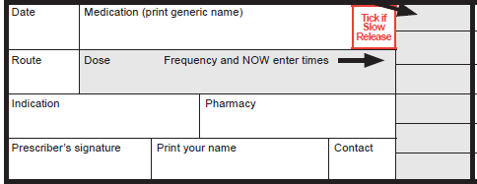
Medicine order section
Medicine name not complete and correct
Record the number of orders where the medicine name is not complete and correct with potential for error identified
Refer to local policy to determine if generic or brand name is considered correct
Is this complete and correct?

Slide 34
Medicine order section
Route not complete and correct
Record the number of orders where route is not complete and correct, with potential for error identified
Is this complete and correct

Slide 35
Medicine order section
Dose not complete and correct
Record the number of orders where dose is not complete and correct, with potential for error identified
Note: when referring to paediatric patients, consider correctness and consistency with any dose calculations documented on the chart
Is this complete and correct

Slide 36
Medicine order section
Frequency not complete and correct
Record the number of orders where frequency is not complete and correct with potential for error identified
Does this match?

Slide 37
Medicine order section
Prescriber Name not legible on the chart
Record the number of orders where the prescriber’s name is not legibly written somewhere on the chart containing the order.
Note: Prescribers should print their surname at least once on the medication chart to enable other clinicians to identify their signature.
Is prescriber’s name legible?

Slide 38
Medicine order section
Prescriber Signature
Record the number of orders where the prescriber has not signed the order
Is the order signed?

Slide 39
Medicine order section
How many medicines orders contain one or more of the above errors
The following relate to questions
  3.3
  4.3
  5.4
Record the number of orders where one or more of the errors specified were identified
Do not record the total number of errors

Slide 40
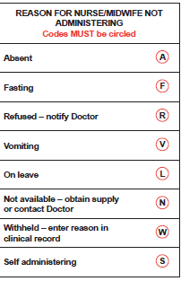
Medicine order section
Doses Required
Record the number of doses that should have been administered from the commencement of the order on the active chart to the time of the audit.
Relates to Q 3.8, 5.5, 14.5 &15.7
Doses Missed
Record the number of doses that have been missed, without a reason for not administering specified.
Relates to Q 3.9, 5.6, 14.6 &15.8
Refer to these codes

Slide 41
Section 3
Regular Medicine orders
Applies to all medicine orders in the regular sections of all active charts in current use at time of auditing
Excludes ceased medications
3.1 Total number of regular medicine orders (if ‘0’, go to section 4)
3.2 Record the number of orders in this section where the following errors are identified:
Order not legible
Order contains one or more error-prone abbreviation(s)
Medicine name not complete and correct
Route not complete and correct
Dose not complete and correct
Frequency not complete and correct
Prescriber name not legible on the chart
Order not signed by prescriber
3.3 How many regular medicine orders contain one or more of the above errors?
3.4 Total number of SR medicines orders
3.5 Number of orders where SR box is not ticked for SR medicines
3.6 Number of orders where indication is not documented
3.7 Number of orders where dose calculation is not documented for patients aged 12 years or under (NIMC paediatric only)
3.8 Total number of required doses prescribed in the regular medicines section
3.9 How many doses were missed without a reason for not administering specified?

Slide 42
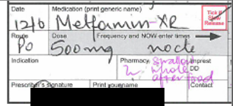

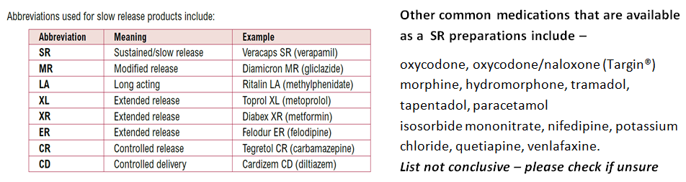
Section 3
Regular Medicine orders
3.4 Number of SR medicines ordered
Record the number of medicine orders that are slow release (SR) or modified release, regardless of whether the ‘SR’ box has been ticked
3.5 Number of orders where SR box is not ticked for SR medicines

Slide 43
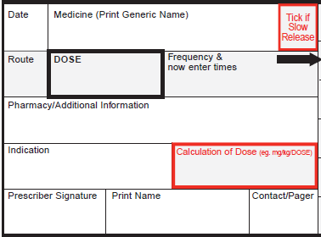
Section 3
Regular Medicine orders
3.6 Number of orders where indication is not documented
3.7 Number of orders where dose calculation is not documented for patient aged 12 years or younger
(NIMC paediatric only)
What is this drug being used for?
Look here

Slide 44
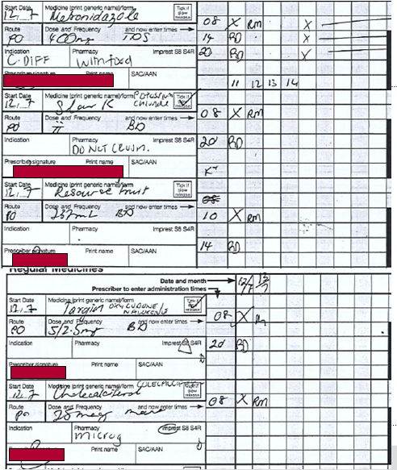
Regular Medicine orders
3.1 Total number of regular medicine orders (if ‘0’, go to section 4) | 4
3.2 Record the number of orders in this section where the following errors are identified:
Order not legible | 1
Order contains one or more error-prone abbreviation(s) | 2
Medicine name not complete and correct | 2*
Route not complete and correct | 0
Dose not complete and correct | 0
Frequency not complete and correct | 0
Prescriber name not legible on the chart | 0
Order not signed by prescriber | 0
3.3 How many regular medicine orders contain one or more of the above errors? | 3
3.4 Total number of SR medicines orders | 2
3.5 Number of orders where SR box is not ticked for SR medicines | 0
3.6 Number of orders where indication is not documented | 3
3.7 Number of orders where dose calculation is not documented for patients aged 12 years or under (NIMC paediatric only)
3.8 Total number of required doses prescribed in the regular medicines section | 8
3.9 How many doses were missed without a reason for not administering specified? | 0
This order is a nutritional supplement and therefore not counted in the audit

Slide 45
Section 3 explanation
3.1 count up all medication orders (does not include nutritional supplements)
3.2
  order not legible – relates only to handwriting (mane is difficult to read)
  error prone = ‘ii’ and ‘mcg’ are both incorrect
  Medicine name not complete and correct = ‘Targin’ and ‘Slow K’ (*But this may depend on hospital policy)’
3.3 = 3 (Targin, Slow K and Cholecalciferol orders) count all the orders that had 1 or more of the above errors

Slide 46
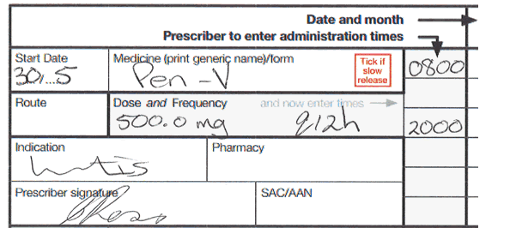
More examples of unapproved abbreviations and errors in charting
Acknowledgement - NPS NSMC 2018 Course

Slide 47
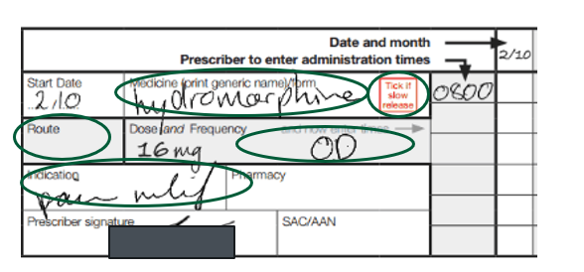
More examples of unapproved abbreviations and errors in charting
Acknowledgement – NPS NSMC 2018 Course

Slide 48
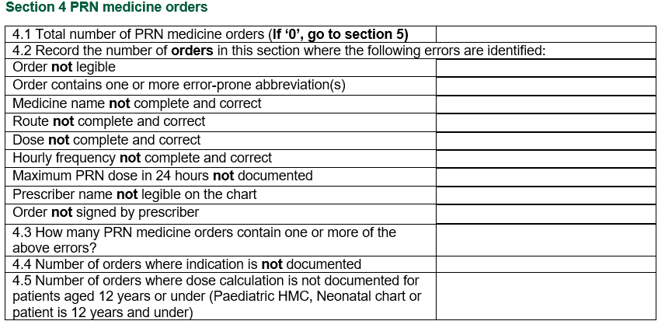
Section 4
PRN Medicine orders
Applies to all medicine orders in the PRN sections of all active charts in current use
Excludes ceased medications

Slide 49
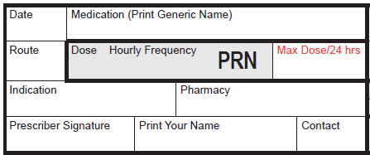
Section 4
PRN Medicine orders
Hourly frequency not complete and correct
Maximum PRN dose in 24 hours not documented
Is this complete and correct?
Has this been completed?

Slide 50
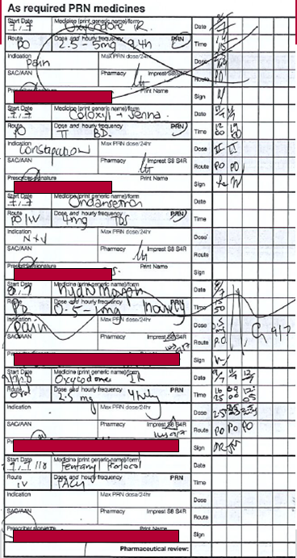
Section 4
PRN medicine orders
4.1 Total number of PRN medicine orders (if ‘0’, go to section 5) | 4
4.2 Record the number of orders in this section where the following errors are identified:
Order not legible | 0
Order contains one or more error-prone abbreviation(s) | 2
Medicine name not complete and correct | 0
Route not complete and correct | 0
Dose not complete and correct | 1
Hourly frequency not complete and correct | 1
Maximum PRN dose in 24 hours not documented | 4
Prescriber name not legible on the chart | 0
Order not signed by prescriber | 0
4.3 How many PRN medicine orders contain one or more of the above errors? | 4
4.4 Number of orders where indication is not documented | 2
4.5 Number of orders where dose calculation is not documented for patients aged 12 years or under (NIMC paediatric only)

Slide 51
Section 4 explanation
4.1 – only count the active orders on the chart
4.2
  error prone abbreviation = ‘ii’ and ‘IR’
  dose not complete and correct = the fentanyl protocol order only states PACU
  hourly frequency = fentanyl protocol order dose not have an hourly frequency prescribed
Depending on local protocol the fentanyl order may be considered complete and correct if it follows local guidelines

Slide 52
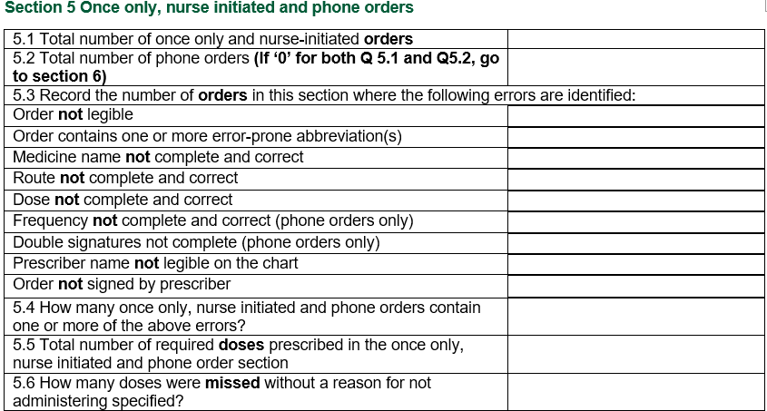
Section 5
Once only, nurse initiated and phone orders
Applies to all medicine orders in the once only, nurse initiated and phone order sections of all active charts in current use
Excludes ceased medications

Slide 53

Prescribing and Administration
Double signature not complete (phone order only)
Are there two signatures here?

Slide 54
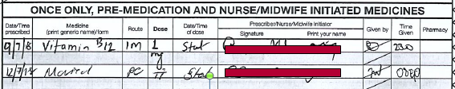
Once only, nurse initiated and phone orders
5.1 Total number of once only and nurse initiated orders | 2
5.2 Total number of phone orders (If ‘0’ for both Q 5.1 and Q5.2, go to section 6) | 0
5.3 Record the number of orders in this section where the following errors are identified:
Order not legible | 1
Order contains one or more error-prone abbreviation(s) | 1
Medicine name not complete and correct | 1
Route not complete and correct | 0
Dose not complete and correct | 0
Frequency not complete and correct (phone orders only) | 0
Double signatures not complete (phone orders only) | 0
Prescriber name not legible on the chart | 0
Order not signed by prescriber | 0
5.4 How many once only, nurse initiated and phone orders contain one or more of the above errors? | 1
5.5 Total number of required doses prescribed in the once only, nurse initiated and phone order section | 2
5.6 How many doses were missed without a reason for not administering specified? | 0
5.3 Movicol order is illegible
Error prone = roman numeral ‘ii’
Medicine name not complete – depending on hospital policy the use of Movicol may not be appropriate and considered incorrect
Record the total number of orders with one or more errors, not total number of errors.

Slide 55
Section 6 Option to complete non mandatory sections of audit
Do you wish to complete any of the non-mandatory sections of the audit | Y / N
If you select Y, you will be prompted to add additional data in the non-mandatory sections of the audit If you select N, you will be prompted to complete the audit.
For sites who want to complete non compulsory sections of the audit, ensure you select 'Yes' and then you will be prompted to add additional audit data.
Please note that none of the questions in this section are compulsory, sites can choose which sections to audit.

Slide 56
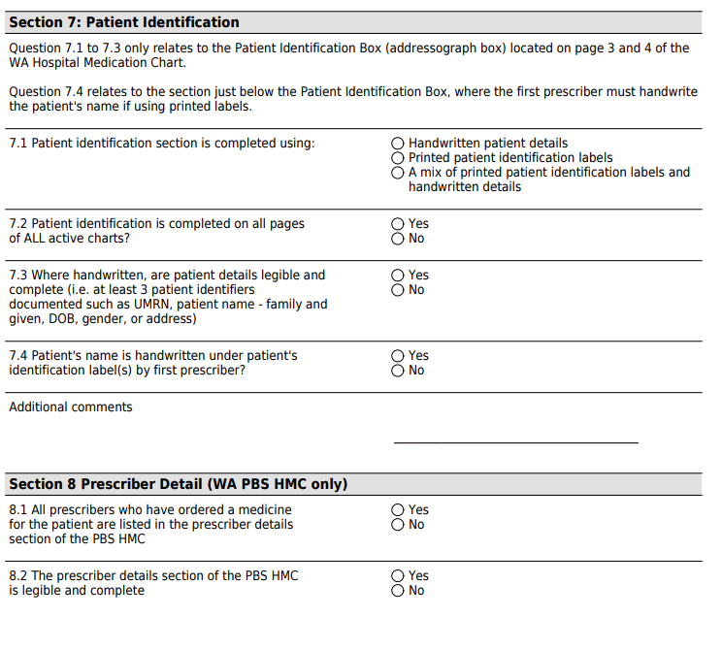
Section 7 and 8

Slide 57
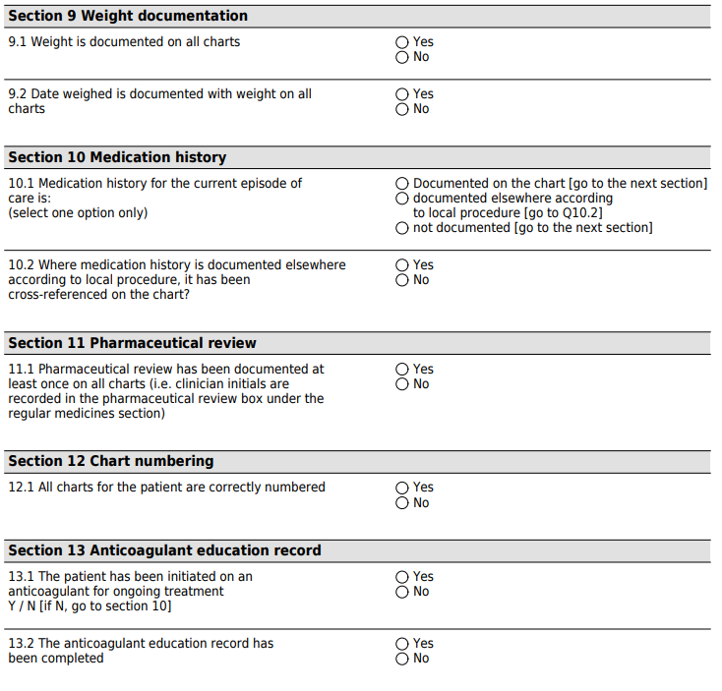
Section 9 -13

Slide 58
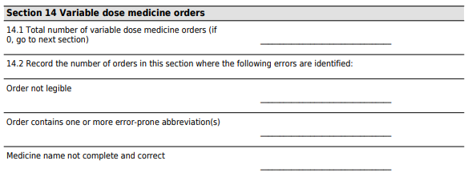
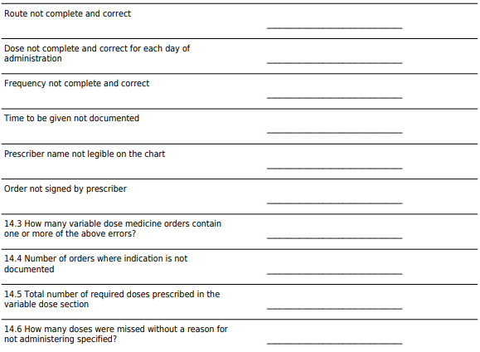
Section 14

Slide 59
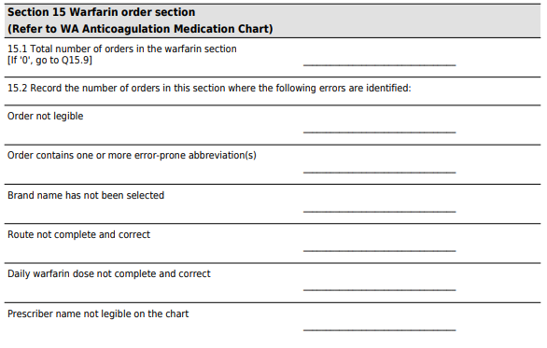
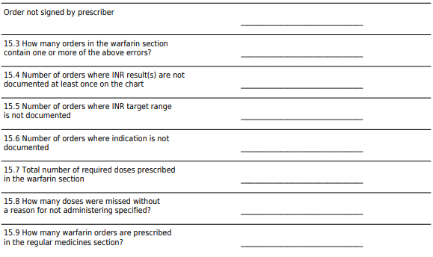
Section 15

Slide 60
Acknowledgements
This local WA NSMC Audit 2026 has been adapted from the Australian Commission on Safety and Quality in Health Care NSMC Audit.
https://www.safetyandquality.gov.au/our-work/medication-safety/nsmc-audit
REDCap® Audit Link:
https://redcap.link/NIMC2026
WA specific resources can be found here:
WA hospital medication chart (adult and paediatric) (health.wa.gov.au)
WA Medication Safety Intranet page

