Slide 1
Western Australian Multidisciplinary Post Fall Management Guidelines: Physiotherapy
2018

Slide 2
Information about this PowerPoint
It provides a summary of the updated Post Fall Multidisciplinary Management Guidelines for Western Australian Health Care Settings 2018.
It is designed to assist in the education of all health professionals involved in the care of a patient post fall.
All health professionals involved in the care of a patient post fall should receive this information.
It is a basic outline and contains only essential information.
It can be adapted to suit your local area and staff.
Refer to the complete guidelines.
Supplementary notes are given below the slides.
The application of local policy may indicate alternative actions or other policies to meet requirements.
Please contact Falls.ManagementWA@health.wa.gov.au
if you have any questions/comments or feedback

Slide 3
Role of Physiotherapist
The role of Physiotherapy is integral to the multidisciplinary management and care of patients who are at risk of falling, or who have fallen.
Local Policy May Apply to Some of These Actions

Slide 4
4 main components for Physiotherapy review of a patient following a fall
1. Assessment
2. Intervention
3. Documentation
4. Discharge Planning

Slide 5
Note:
Important to involve carers throughout the process where possible.
Physiotherapists are well placed to monitor for any behavioural or thinking changes in their patients.
Escalating any concerns to the Medical Team.
Notes:
It is important to involve carers throughout the process where possible, especially for patients with Cognitive Impairment.
During their interactions with patients, Physiotherapists are well placed to monitor for any behavioural or thinking changes in their patients that could indicate a delirium, escalating any concerns to the Medical Team.

Slide 6
Assessment
Once notified patient should be reviewed within 2 working days.
Review details, and results.
Ensure patient has been cleared to mobilise by the Medical Officer.
If verbal consent document this and their name and contact details.
Local Policy May Apply to Some of These Actions
Notes:
As per local policy

Slide 7
Assessments include:
Mobility
Strength
Balance
Other assessments deemed appropriate and necessary
It is important to note that if the patient is unable to participate in the assessment due to pain, difficulty in weight-bearing or acute confusion, the physiotherapist should refer back to the MO for further review / investigations.
Notes:
An assessment may include, but is not limited to, a mobility, strength and balance assessment and any other assessments or outcome measures determined appropriate at that point in care.
It is important to note that if the patient is unable to participate in the assessment due to pain, difficulty in weight-bearing or acute confusion, the physiotherapist should refer back to the MO for further review / investigations.

Slide 8
Intervention
Muscle strengthening and specific balance components incorporated into programme.
New mobility or manual handling recommendations communicated to staff.
Information should be provided to the patient and their family / carer.
Notes:
Muscle strengthening and specific balance components should be incorporated into any rehabilitation programs provided.
Any new mobility or manual handling recommendations should be clearly relayed to staff which enables the updating of nursing care plans and nursing handover. This includes highlighting the patient as a FALLS RISK as per local policy .
Information should be provided to the patient and their family / carer about falls risk factors, risk reduction strategies, physiotherapy treatment & the ongoing management plan.

Slide 9
Documentation
Clinical assessment findings.
Recommendations and strategies.
Documented to ensure safety when mobilising for patient and staff.
Update FRAMP and any site specific communication tool.
Local Policy May Apply to Some of These Actions

Slide 10
Discharge
Start plans early, involving the patients and their carers in the process.
Post-discharge rehabilitation and falls prevention needs should be identified.
Referrals and handovers to appropriate local community services.
Utilise the local service discharge log.
Local Policy May Apply to Some of These Actions

Slide 11
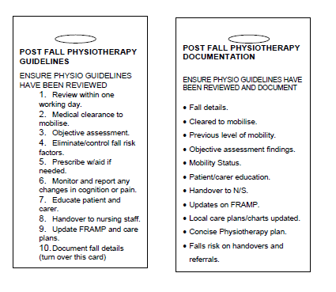
Resources (refer to Appendices 3.1 and 3.2 in the Guidelines)
Post Fall Lanyard

Slide 12
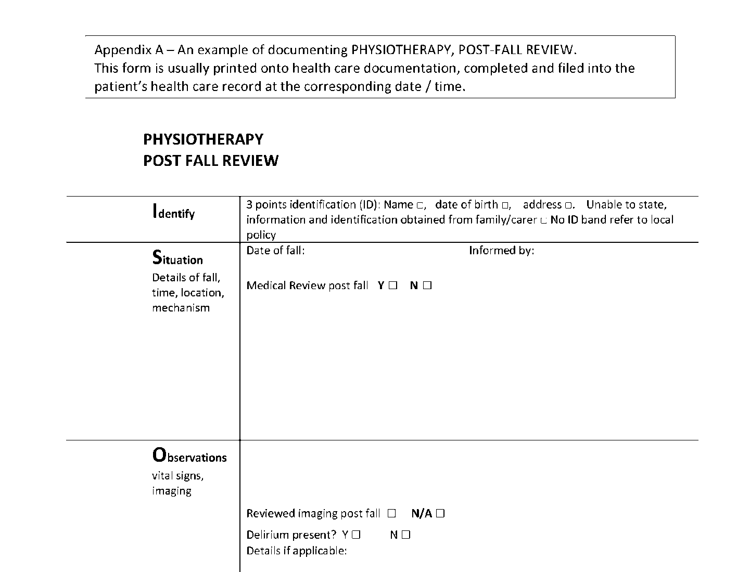
Post Fall Assessment Proforma
Sample
Notes:
See guidelines for a clear version. Available from website or contact Falls.Management@health.wa.gov.au

Slide 13
Summary
The role of Physiotherapy is integral to the multidisciplinary management and care of patients who are at risk of falling, or who have fallen.
The guidelines have developed by the Physiotherapists within the Western Australian Multidisciplinary Post Fall Guideline Working Party 2018 as evidenced based care for the patient post fall.
State-wide consultation of consumers, health professionals including aboriginal and untrained health care staff has occurred during the guideline development.
The guidelines are to be utilised in conjunction with the Post Fall Management Guidelines in Western Australian Healthcare Settings 2018.
Contact Falls.Management@health.wa.gov.au for more information

Slide 14
Quiz questions
The following are quiz questions that can be utilised in conjunction with education on the Physiotherapy Post Fall Guidelines

Slide 15
Questions
In the absence of documented clearance to mobilise following an inpatient fall, is verbal approval to mobilise a patient sufficient?
No
Yes from the patients nurse
Yes from a DR with their name and contact details documented.
If a patient is unable to participate in the Physiotherapy assessment due to pain, difficulty weight-bearing or acute confusion, what is recommended:
Keep going - no pain no gain!
Press the medical emergency alarm
Stop the assessment and inform the medical officer for further review
What should physiotherapists monitor for during their interactions with patients?
Changes in the patients thinking or behaviour that could indicate a delirium
Signs of clinical deterioration
Environmental Hazards
All of the above

Slide 16
Questions Continued…
Where would physiotherapists document patient education provided?
The FRAMP
Patient medical record
Where would the Physiotherapist document their assessment findings and recommendations'?
The FRAMP
Patient Care Plan
Mobility Chart
Any other site specific tool or document, as per local policy
All of the above
Who would they inform of these recommendations?
The staff
The Patient
The Family / carer of the patient
All of the above
When would the Physiotherapist involve the patient and their carer?
Only when asked by the patient and carer
Only for patients with cognitive impairment
At each stage of the patients journey

